Slide 1
BBC News Classification
Business,Entertainment,Politics,Sports,Technology

Slide 2
Algorithms
Supervised
Semi-Supervised

Slide 3
Libraries
Tokenize
Remove stop-words
Lemmatization

Slide 4
Approaches:
Naive Base
Multinomial
Doc 2 Vec
Multi LAyer Perceptron(Keras)

Slide 5
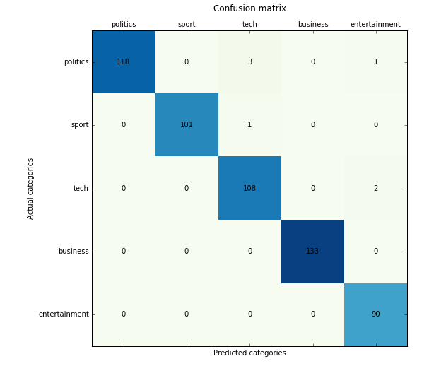
Naive Bayes approach:Confusion Matrix

Slide 6
Naive Bayes approach:
Best score | 0.979017
Best accuracy | 0.987433
Precision score | 0.987433 (micro) 0.986406 (macro)
Recall score | 0.987433 (micro) / 0.987845 (macro)
F1 score | 0.987433 (micro) / 0.986997 (macro)

Slide 7
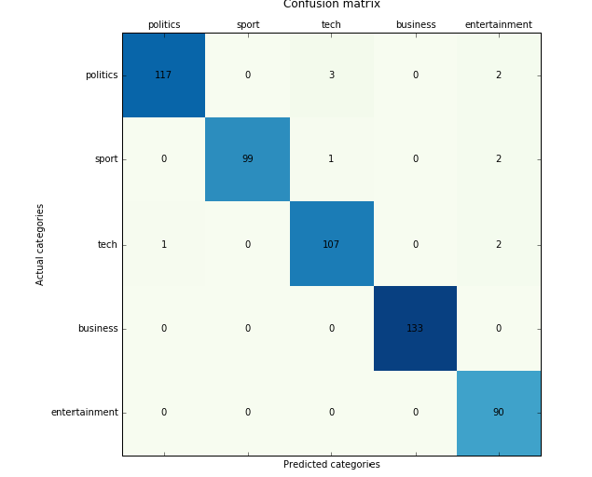
Multinomial Tfid Vectorizer approach:Confusion Matrix

Slide 8
Multinomial Tfid Vectorizer approach::
Best score | 0.981415
Best accuracy | 0.980251
Precision score | 0.980251 (micro) / 0.978598 (macro)
Recall score | 0.980251 (micro) / 0.980466 (macro)
F1 score | 0.980251 (micro) / 0.979228 (macro)

Slide 9
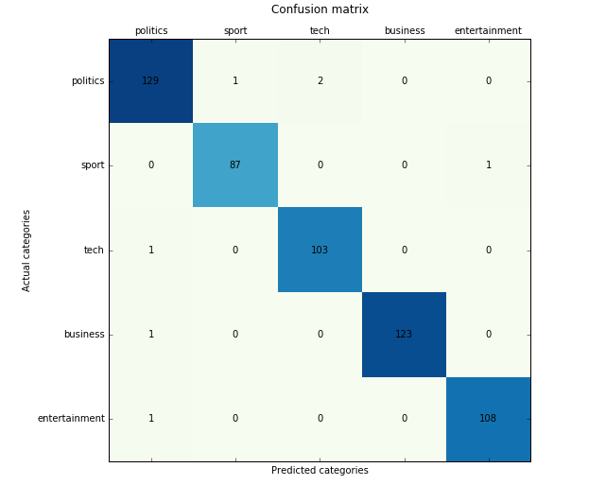
Doc 2Vector(Support Vector Machine )approach:Confusion Matrix

Slide 10
Doc 2Vector(Support Vector Machine )approach:approach::
Best score | 0.968825
Best accuracy | 0.980251
Precision score | 0.987433 (micro) / 0.987537 (macro)
Recall score | 0.987433 (micro) / 0.987811 (macro)
F1 score | 0.987433 (micro) / 0.987666 (macro)

Slide 11
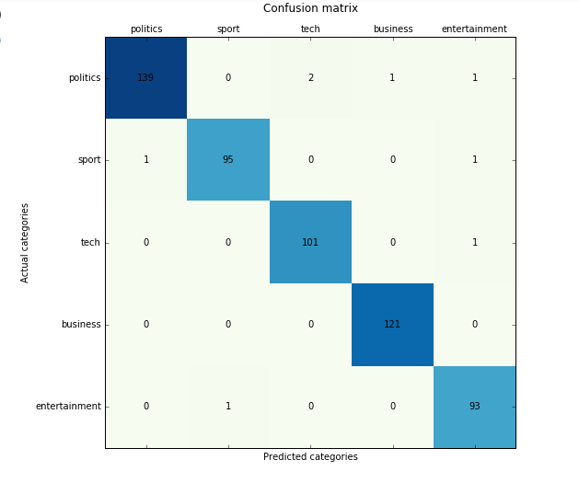
Multi-layer Perceptron (Keras-based) approach:Confusion Matrix

Slide 12
Multi-layer Perceptron (Keras-based) approach:approach::
Best score | 0.968825
Best accuracy | 0.956912
Precision score | 0.985637 (micro) / 0.984715 (macro
Recall score | 0.985637 (micro) / 0.986193 (macro)
F1 score | 0.985637 (micro) / 0.985397 (macro)

Slide 13
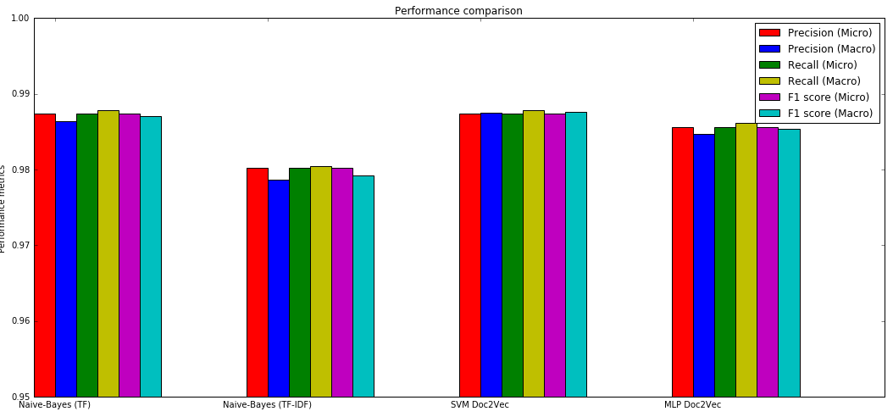
Performance Comparison

